Slide 1
Karen Gefvert
Director of Governmental Relations
Wisconsin Farm Bureau Federation

Slide 2
Agricultural Policy
Where Does it Come From?
Public Outcry
Mercy for Animals Video
Raw Milk
Organizational Priorities
High Capacity Wells
Implements of Husbandry

Slide 3
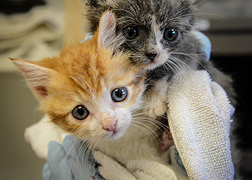
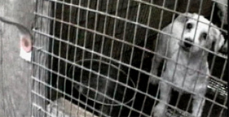
Who Are We “Up Against”?

Slide 4
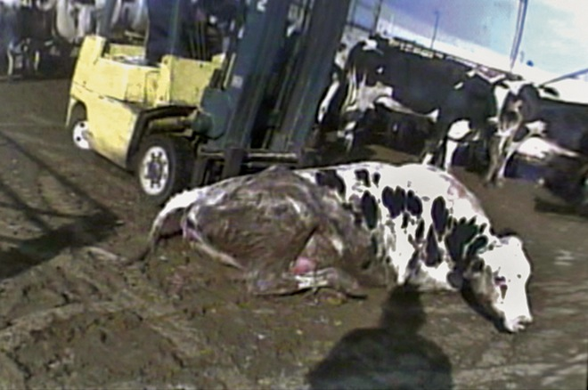
Who Are We “Up Against”?

Slide 5
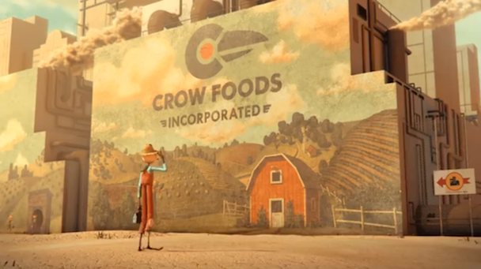
Who Are We “Up Against”?
Notes:
So, why is what we do so important?
Misconception in agriculture is growing & people are becoming more disconnected from it. – consumers are being fed misinformation
This includes legislators!
Messaging works because it tugs at the heart strings or it grosses people out.
The other part that works in our favor is the “warm & fuzzy”
Social Media – stories about how you care for your animals, raise them, take care of them when they’re sick, why and how you use antibiotics
Importance of WOMEN! – YOU have TONS of credibility
Mothers – Wives - Providers – Decision makers about food in your homes & on your tables – taking care of children
All of these strategies can be used when discussing agricultural legislation

Slide 6
HOT TOPICS IN AGRICULTURE!
State
Implements of Husbandry
Animal Care Practices
High Capacity Wells
Foreign Land Ownership
Genetically Modified Organisms
Food Labeling
Growing
Raw Milk
Federal
Farm Bill
Water Resources Development Act
Immigration Reform

Slide 7
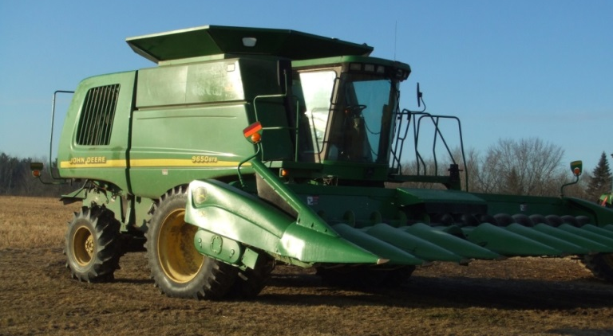
Implements of Husbandry
Today’s farm machinery is modern, efficient & competitive = LARGE & HEAVY
Misconception that IOH are exempt from weight (both farmers & law enforcement)
Increased enforcement in select areas of the state
Balance between farmers and towns and counties responsibility to maintain roads
Do nothing does not solve the problem

Slide 8
Implements of Husbandry
Current Law
Gross Vehicle Weight
80,000 pounds
Axle Weight
20,000 pounds
Width
No limitation for IOH
Proposed Legislation
Gross Vehicle Weight
92,000 pounds
Axle Weight
23,000 pounds
Width
No limitation for IOH but some lighting and marking

Slide 9
Implements of Husbandry
Current Law
Length
Single IOH = no limit
Double IOH = 70’
Triple IOH = 60’
Height
No maximum
Must clear route
Proposed Legislation
Length
Single IOH = 60’
Double IOH = 100’
Triple IOH = 70’ or 100’ w/ 25mph speed limit
Height
No maximum
Must clear route

Slide 10
Implements of Husbandry
What else is included in this legislation?
SB 509 & AB 648
IOH & Ag CMV definitions
Bridge postings and spring thaw limitations both still apply
Exemption for potato harvesters
Allows for incidental movement up to a ½ mile
Many Implements of husbandry are incidentally used on roads

Slide 11
Current Legislative Status
SB 509 passed the State Senate with a bipartisan voice vote on Tuesday, March 11
This included a comprehensive amendment
Legislation must pass the Assembly
Tentatively scheduled for a vote in the Assembly on Tuesday
Will they be the same?
Additional amendments

Slide 12
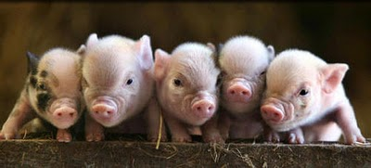
Animal Care Practices
Recent dairy farm video brought attention
HSUS sent letter to Wisconsin Farm Bureau asking us to support banning tail docking
New video from HSUS from a Kentucky pork farm regarding feeding piglet intestines to pigs for PEDv prevention
Farmers need to be proactive
Efforts to increase enforcement against abuse of companion animals can unintentionally effect livestock farmers

Slide 13
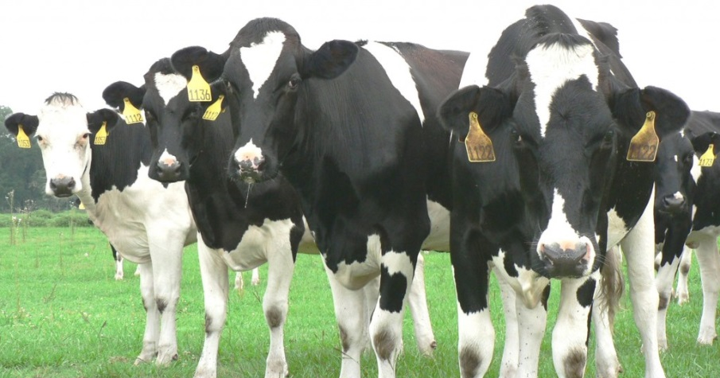
Animal Care Practices
Farmers need to be proactive about how you care for your animals and why high quality care for your livestock is a priority
Explain that animal husbandry practice should be a decision between you and your veterinarian
Wisconsin farmers do not tolerate animal abuse and that it should be reported in a timely manner
Good livestock management is vital to keep animals healthy and productive

Slide 14
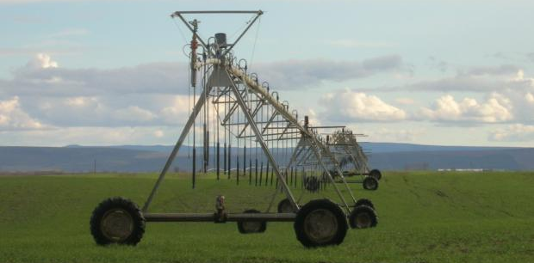
High Capacity Wells
Lake Beulah (East Troy, WI) decision by the State Supreme Court
High Capacity Wells: A well individually, or collectively, that can pump > 100,000 gallons/day (70 gpm) from a single property
DNR Approval for new, replacement or reconstructed High Capacity Wells is Required (approval = permit)
DNR must conduct environmental review
The concern this leaves for current wells, reconstructed wells or replacement wells

Slide 15
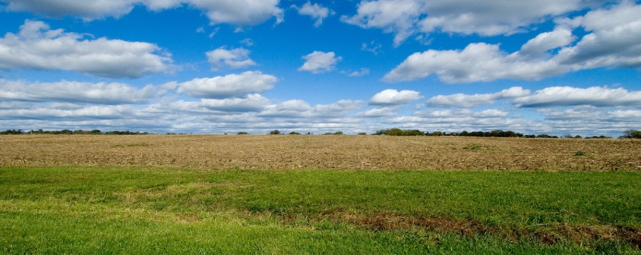
Foreign Land Ownership
Originally in the 2013-2015 budget
Currently, WI law prohibits foreign ownership of ag land in excess of 640 acres
Provision was removed from the budget
Background on where it may have come from
The Attorney General has been asked to issue an opinion if current law limiting foreign ownership of ag land to 640 or less is constitutional

Slide 17
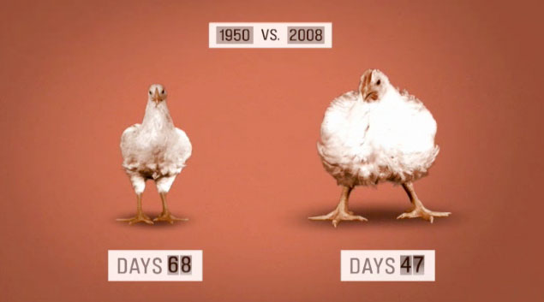
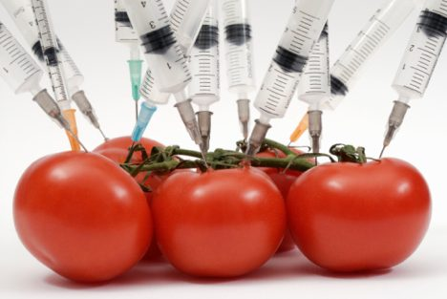
Genetically Modified Organisms
Food Labeling
States
Washington, Colorado, Utah, Maine, Connecticut, Minnesota, Rhode Island, Missouri, Oregon, Arizona, California, Florida, Illinois, New Hampshire, New York, Hawaii & Vermont
Food companies
General Mills - Cheerios
Growing
Cross Contamination
Rejection by foreign countries
China & Corn
History of Genetically Modified
Genetic selection
Radiation

Slide 18
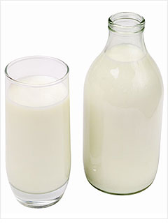
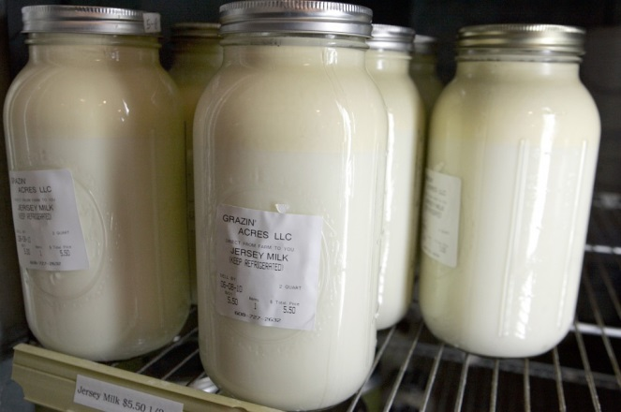
Raw Milk
SB 236 and AB 287 would legalize the sale of raw milk directly to consumers
Court case in Sauk County, WI
Vernon Hershberger
Current law does allow for “incidental sales”

Slide 19
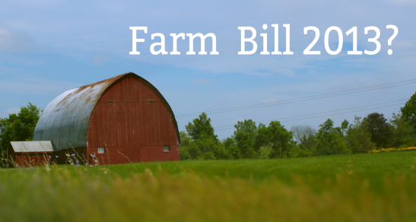
2014 Farm Bill
$488 Billion over 5 years
80% is Supplemental Nutrition Assistance Program (SNAP)
Cuts – not all they’re cracked up to be
$8 Billion from SNAP (10 yrs)
$15 Billion from Agriculture (10 yrs)

Slide 20
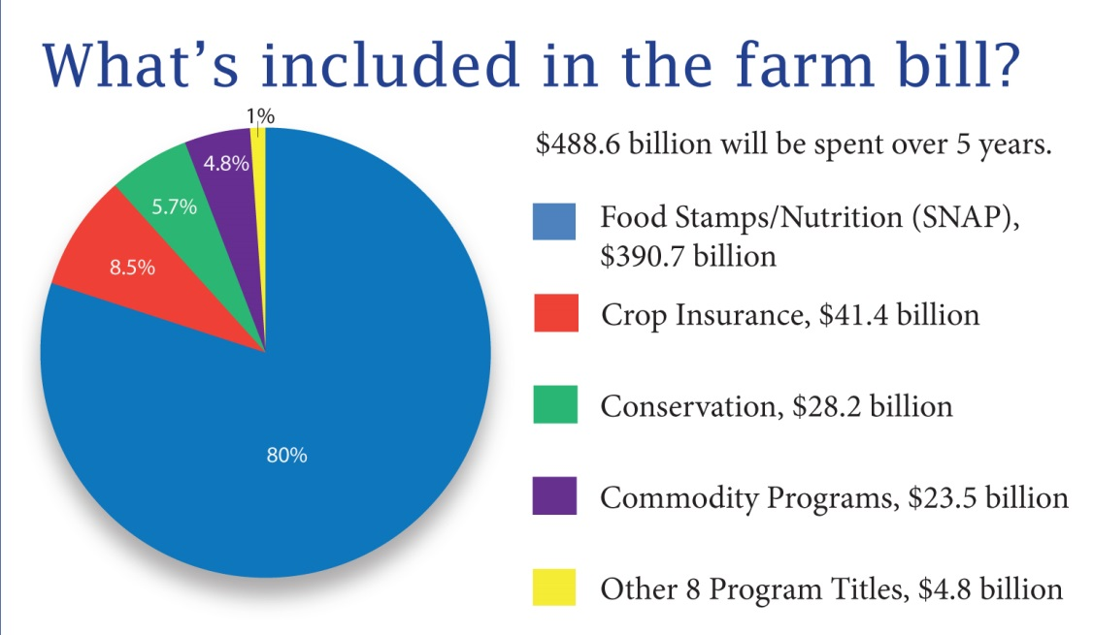
2014 Farm Bill

Slide 21
2014 Farm Bill
Eliminates Direct Payments
Repeals or consolidates almost 100 programs
Significant dairy reform
Strengthens crop insurance
Price Loss Coverage (PLC)
Ag Risk Coverage (ARC)
Stacked Income Protection Plan (STAX)
Supplemental Coverage Option (SCO)

Slide 22
2014 Farm Bill
Livestock Disaster Assistance
Livestock Indemnity Program
Livestock Forage Disaster Program
Payment Limits
Eligibility rules tightened (AGI)
Research & Specialty Crop Research
Cherry, Potato & Cranberry
Organic research, certification & data collection

Slide 23
Water Resources Development Act
Addresses our deteriorating locks & dams and harbors
Importance: Farmers need a consistent transportation mechanism for inputs and outputs for their farming operations
Our infrastructure of waterways and ports are funded through two different trust funds:
Inland Waterways Trust Fund
Harbor Maintenance Trust Fund

Slide 24
Water Resources Development Act
Our lock and dam system was designed to last 50 years, but is approaching 80-years-old
The U.S. lock and dam system is severely outdated and in need of repair
Agriculture relies on the waterways system in order to economically transport agricultural inputs and outputs
It is crucial for farmers to have access to this major transportation thoroughfare and to ensure that it is modernized to be more efficient and reliable

Slide 25
Immigration Reform
Senate
Comprehensive Package
House
Smaller pieces
Administrative delays in current H2A program led to:
Arrival of labor 22 days after needed
Loss of $320 million

Slide 26
Immigration Reform
Senate
Blue Card Program
For experienced farm workers already in the country
Provides an option to work towards green card
Guest Worker Visa Program
Replaces current H2A program
Allows entrance to non-experienced farm labor through a 3 year visa as an agricultural worker
They can be hired on a contract or at-will basis
Labor Cap
Annual limit of just over 12,000 for 3 years

Slide 27
Immigration Reform
House
Border Security & Interior Enforcement
Entry-Exit Visa Tracking System
Employment Verification and Workplace Enforcement
Reforms to the Legal Immigration System
Youth
Currently Individuals Living Outside the Rule of Law

Slide 28
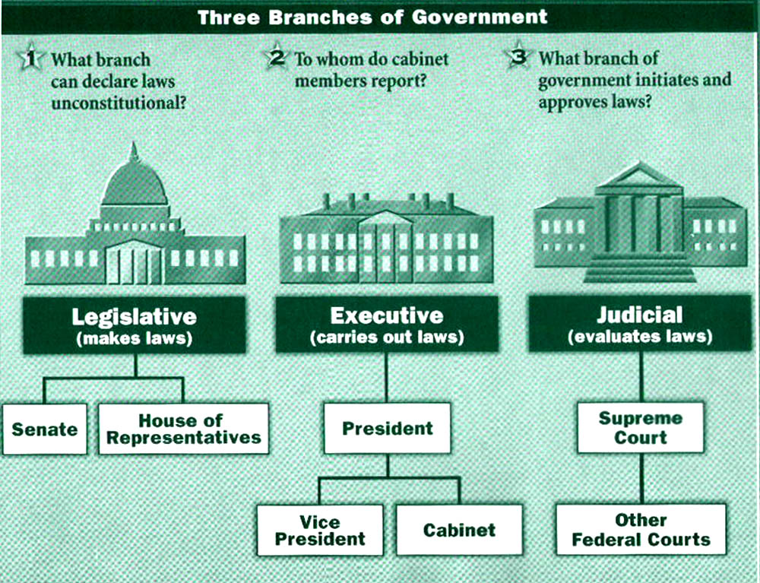
Who Do You Contact?

Slide 29
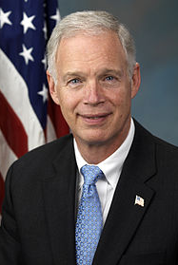
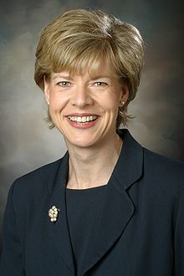
Wisconsin’s United States Senators
Senator Ron Johnson
202-224-5323
Senator Tammy Baldwin
202-224-5653

Slide 30
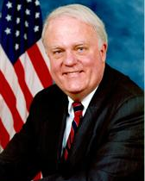
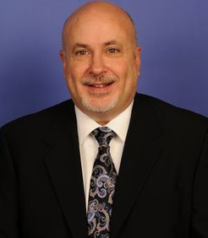
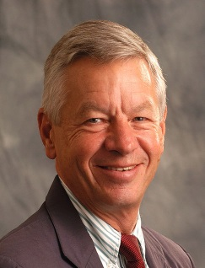
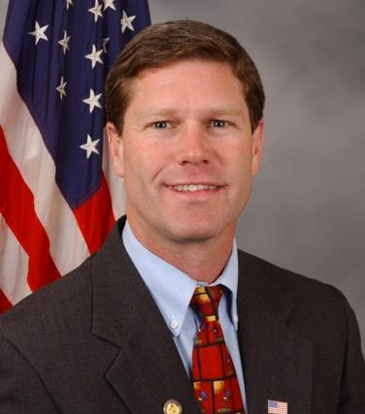
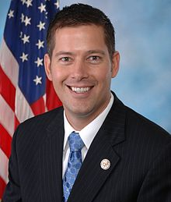
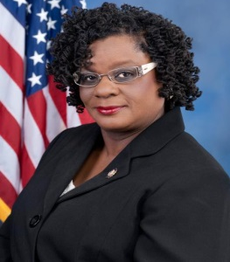
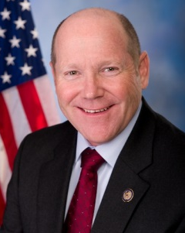
Wisconsin’s Members of the House of Representatives
District 1: Paul Ryan
202-225-3031
District 2: Mark Pocan
202-225-2906
District 3: Ron Kind
202-225-5506
District 4: Gwen Moore
202-225-4572
District 5: Jim Sensenbrenner
202-225-5101
District 6: Tom Petri
202-225-2476
District 7: Sean Duffy
202-225-3365
District 8: Reid Ribble
202-225-5665

Slide 31
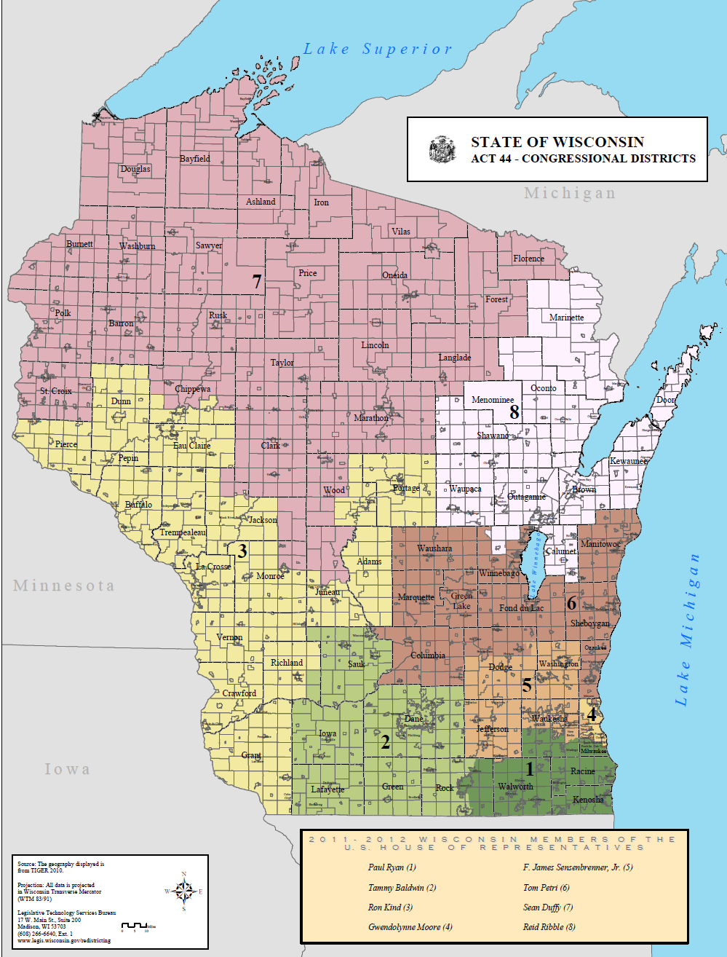

Slide 32
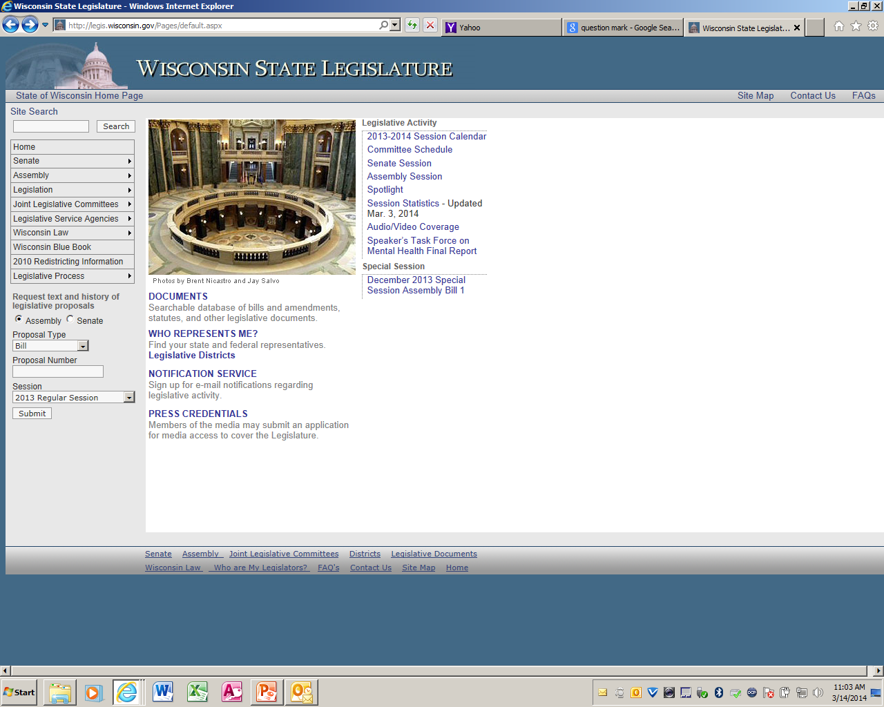

Slide 33
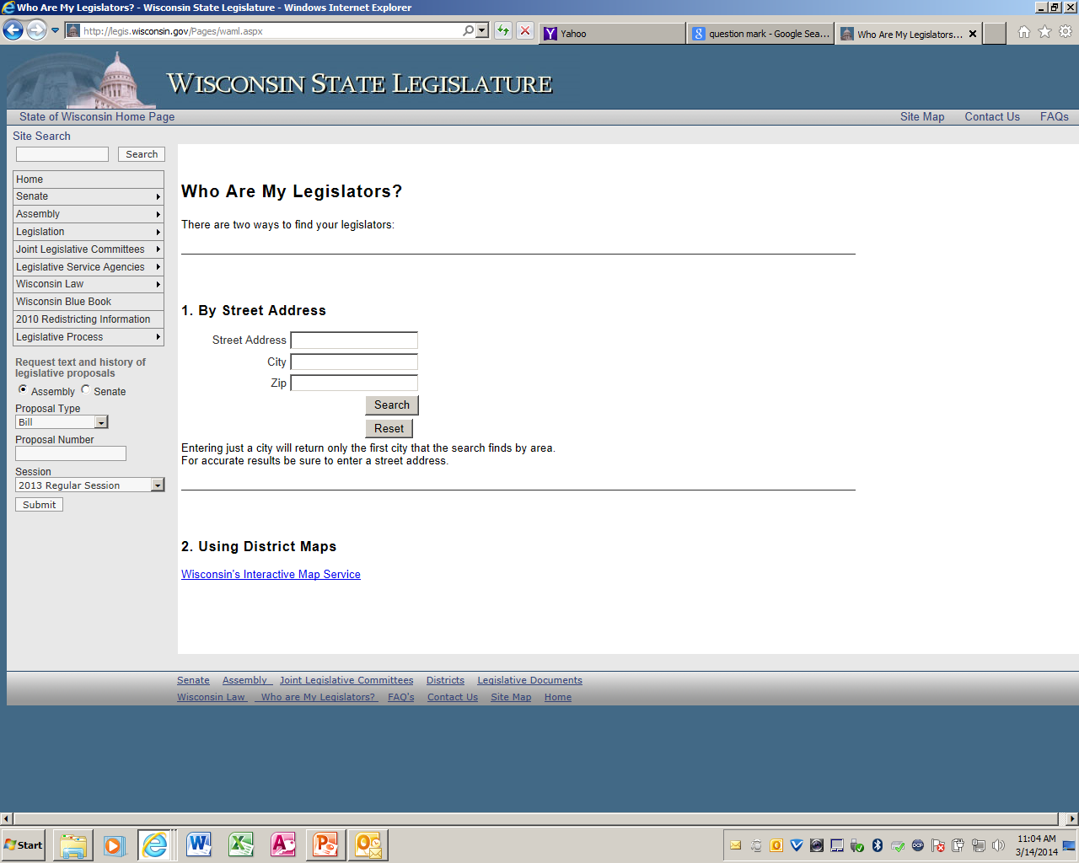

Slide 34
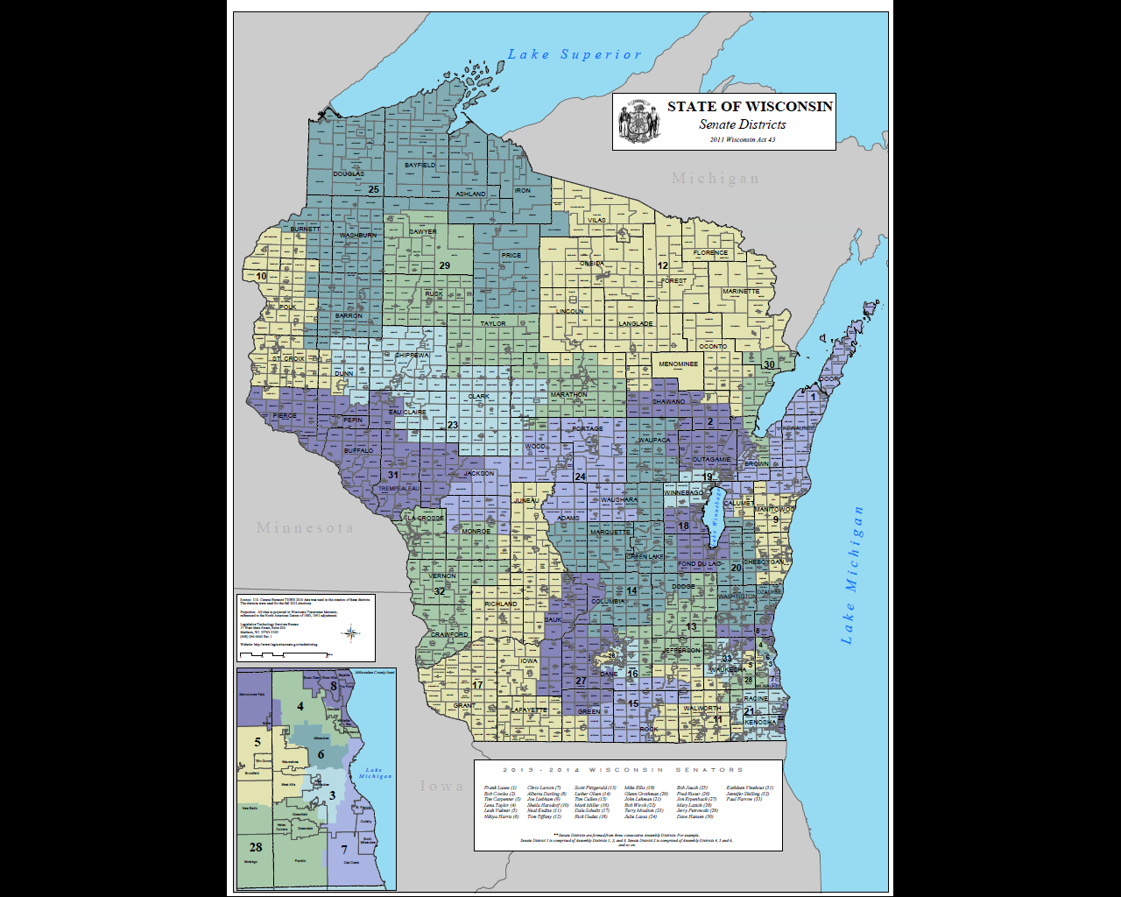

Slide 35
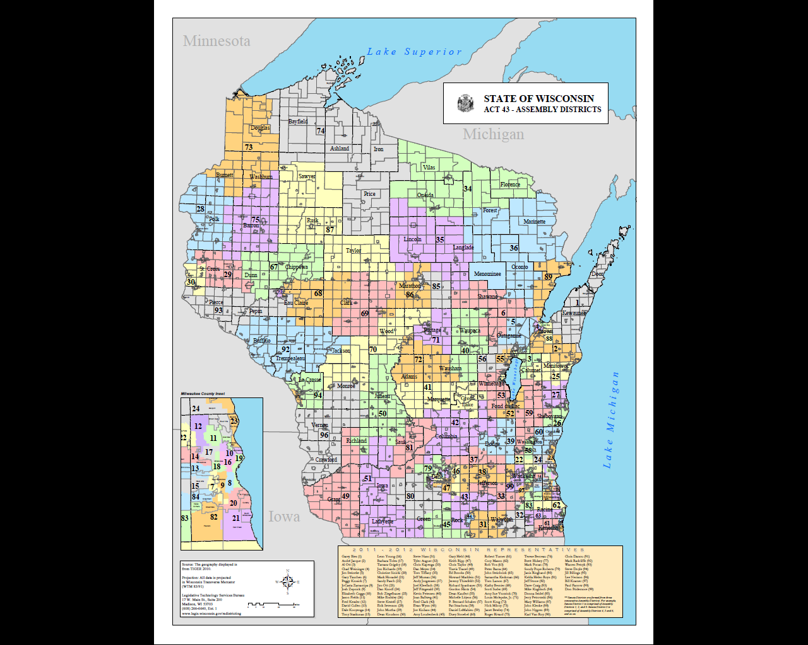

Slide 36
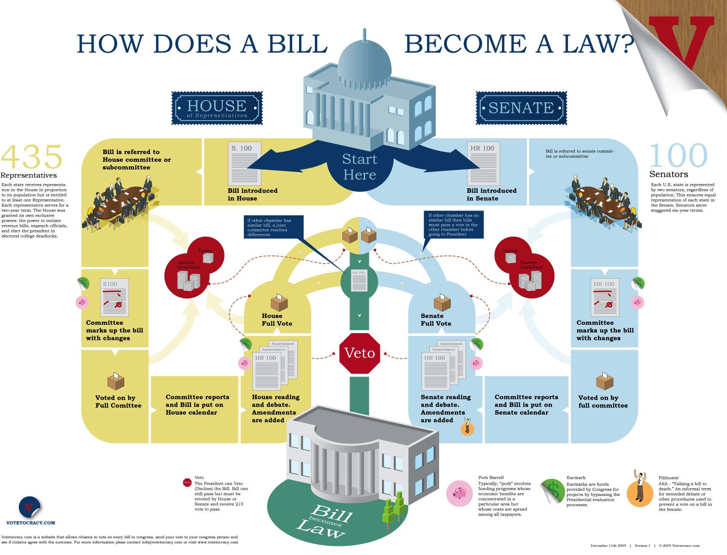

Slide 37
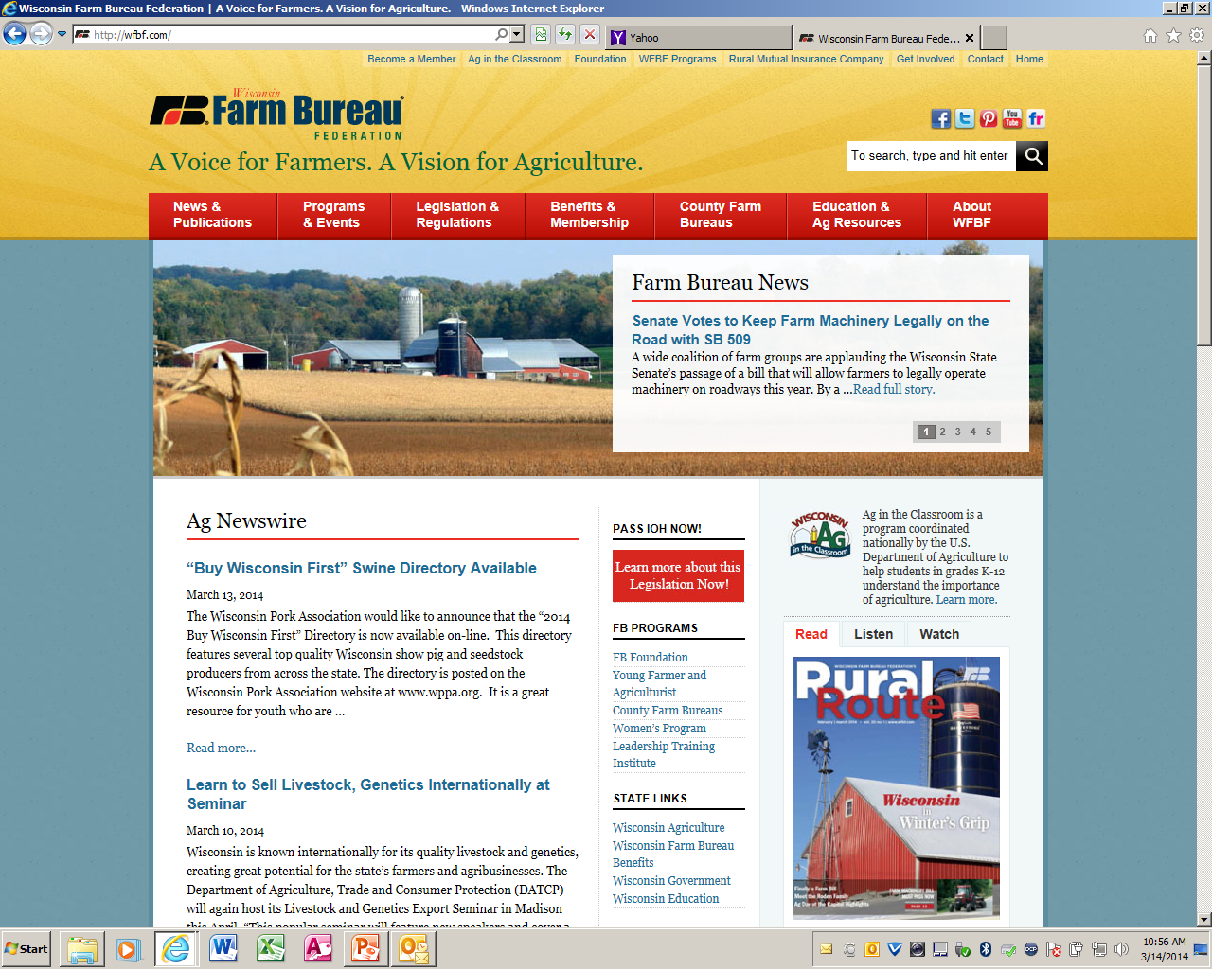

Slide 38
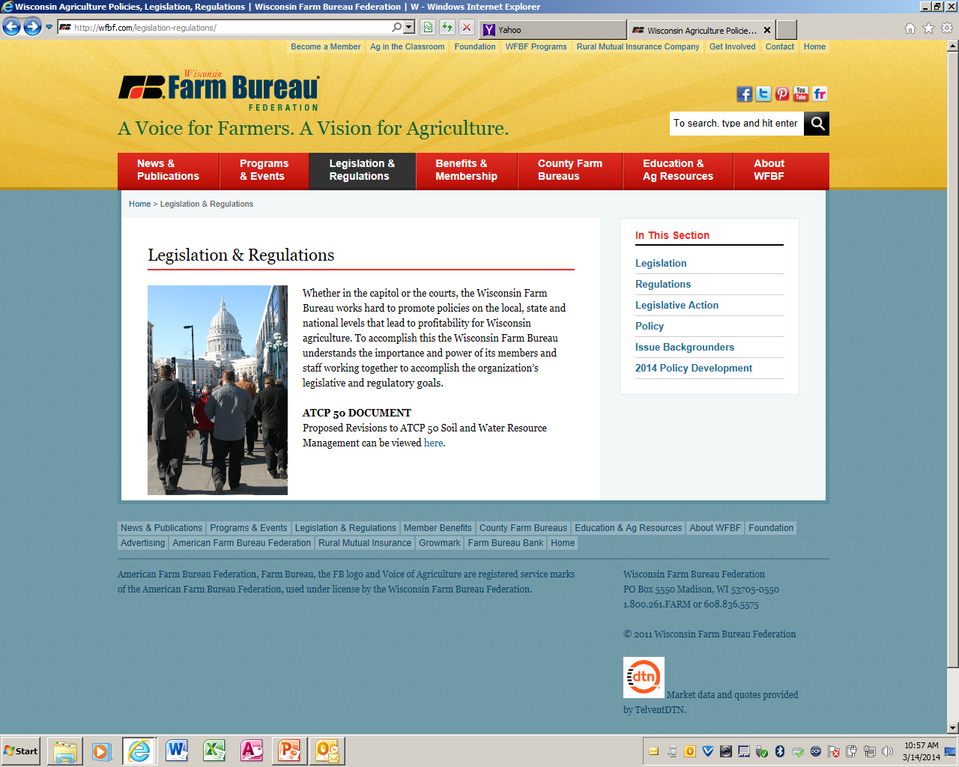

Slide 39
Questions?

